Slide 1


A satellite with homespun electronics
December 2015

Slide 2
INDEX
Problem
Solution
Project Philosophy
Team
Achievements
Tools
Roadmap

Slide 3
INDEX
Problem
Solution
Project Philosophy
Team
Achievements
Tools
Roadmap

Slide 4
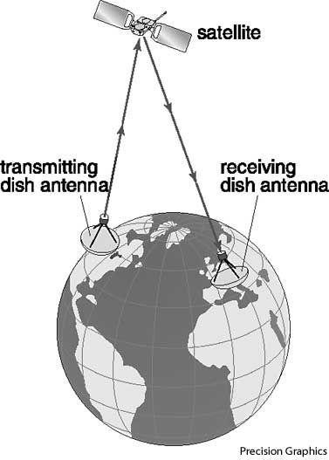
PROBLEM
Classic Satellite Communications
frecuent issues
High costs
Unaccessible
Private owners
Low bandwidth
Maintenance

Slide 5
INDEX
Problem
Solution
Project Philosophy
Team
Achievements
Tools
Roadmap

Slide 6
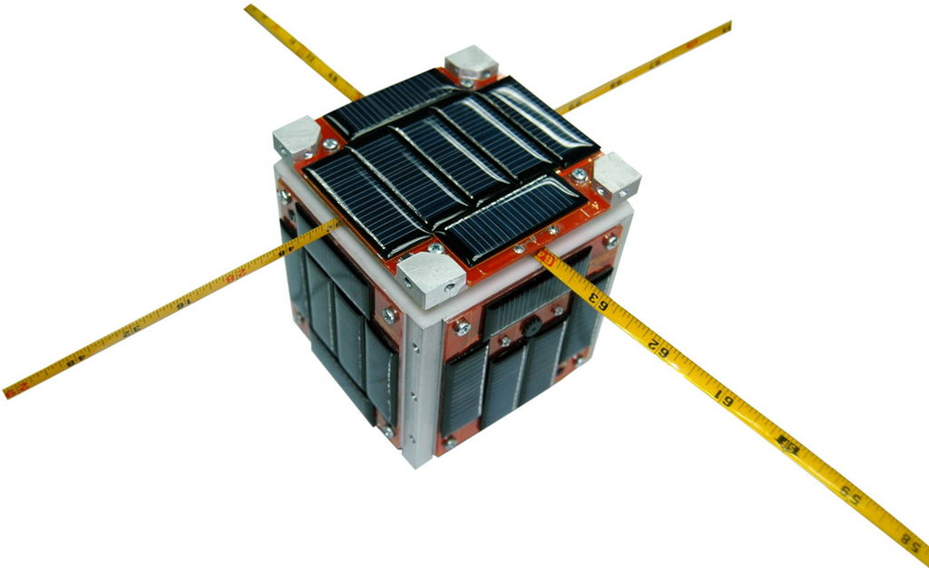
SOLUTION
http://www.cubesat.org/

Slide 7
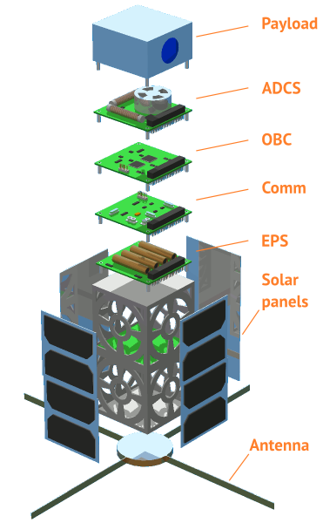
SOLUTION

Slide 8
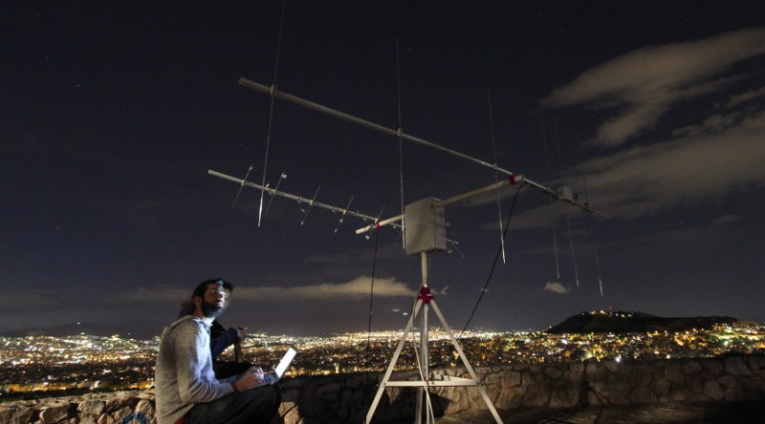
SOLUTION
https://satnogs.org/

Slide 9
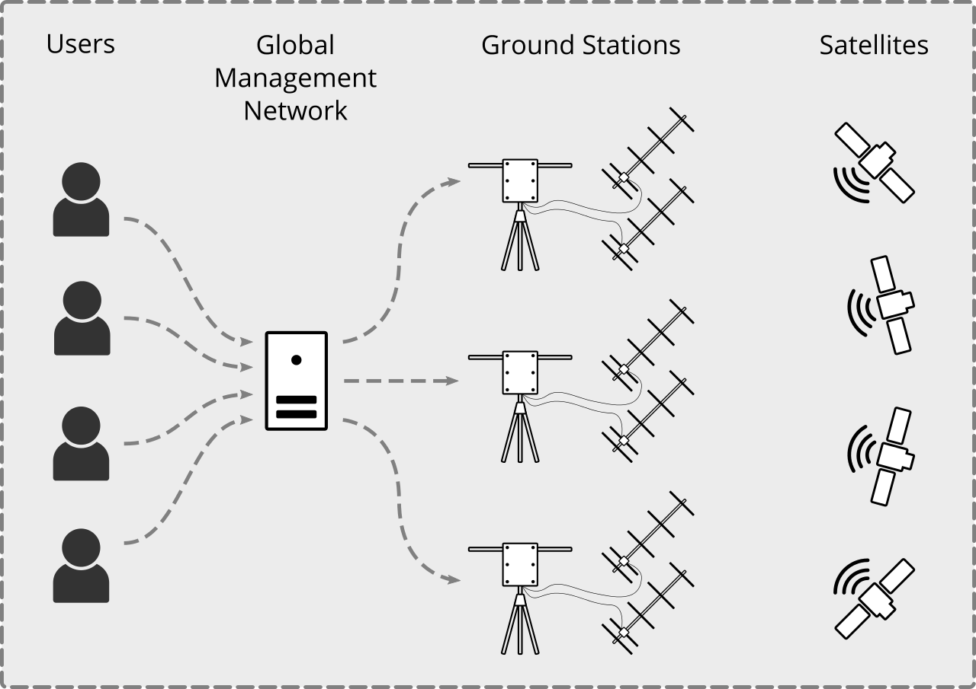

SOLUTION

Slide 10
INDEX
Problem
Solution
Project Philosophy
Team
Achievements
Tools
Roadmap

Slide 11


PROJECT PHILOSOPHY

Slide 12
INDEX
Problem
Solution
Project Philosophy
Team
Achievements
Tools
Roadmap

Slide 13
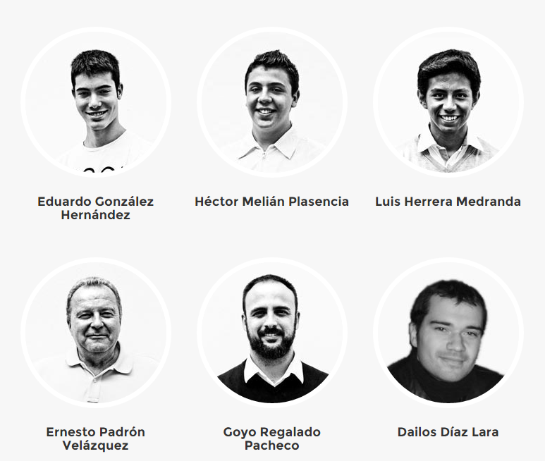
TEAM

Slide 14


TEAM

Slide 15
INDEX
Problem
Solution
Project Philosophy
Team
Achievements
Tools
Roadmap

Slide 16
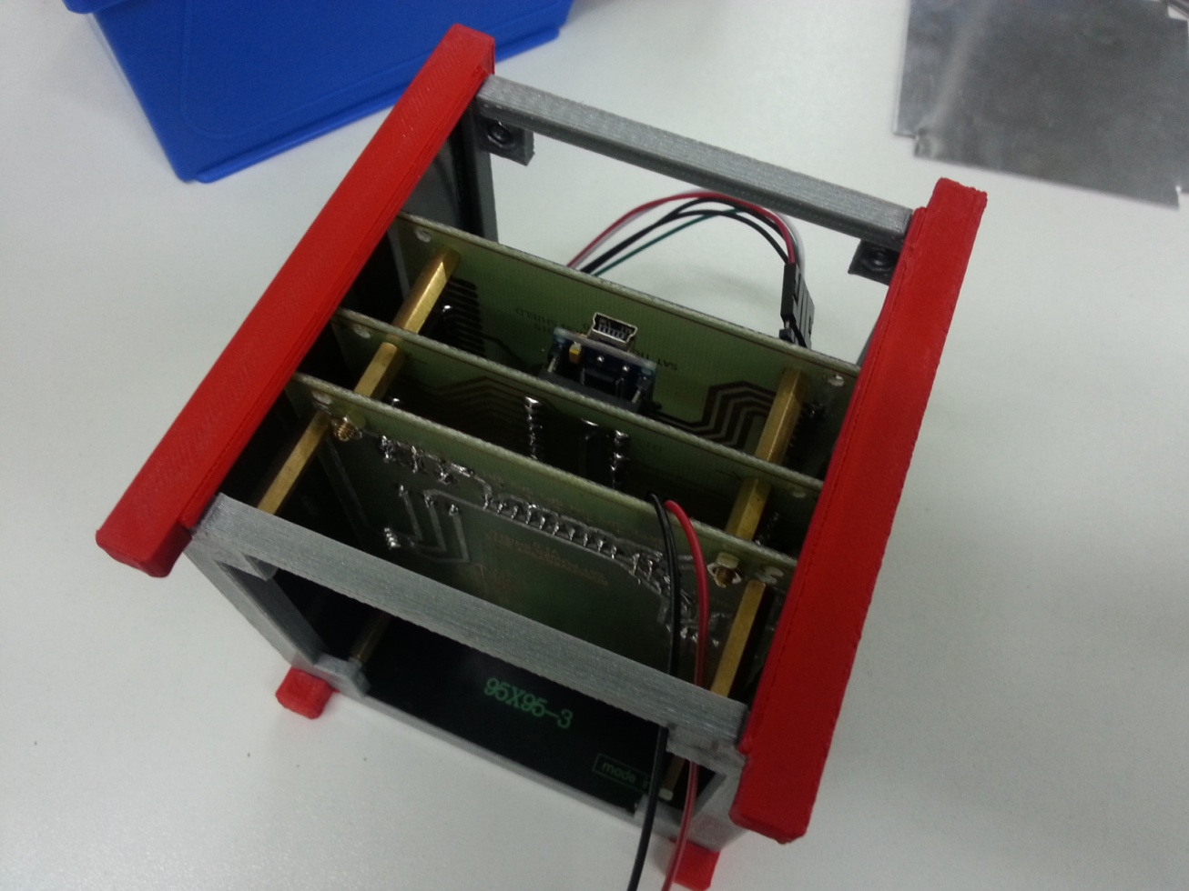
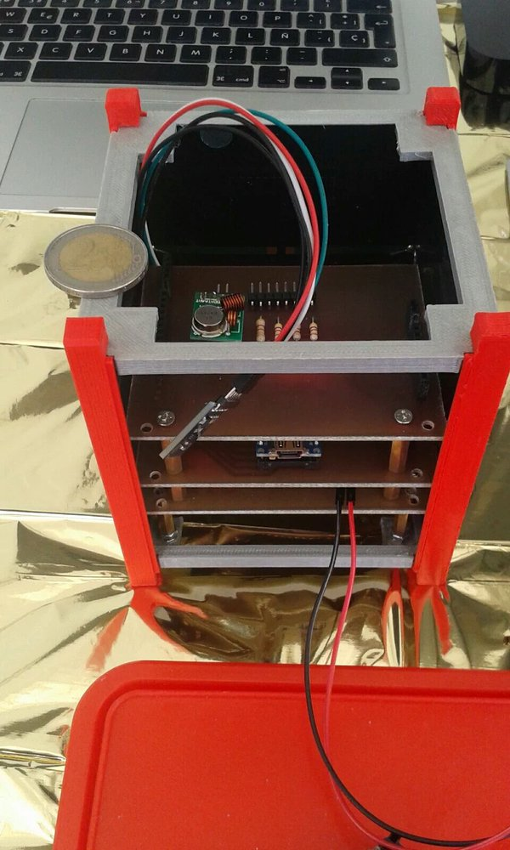
ACHIEVEMENTS
SATELLITE

Slide 17
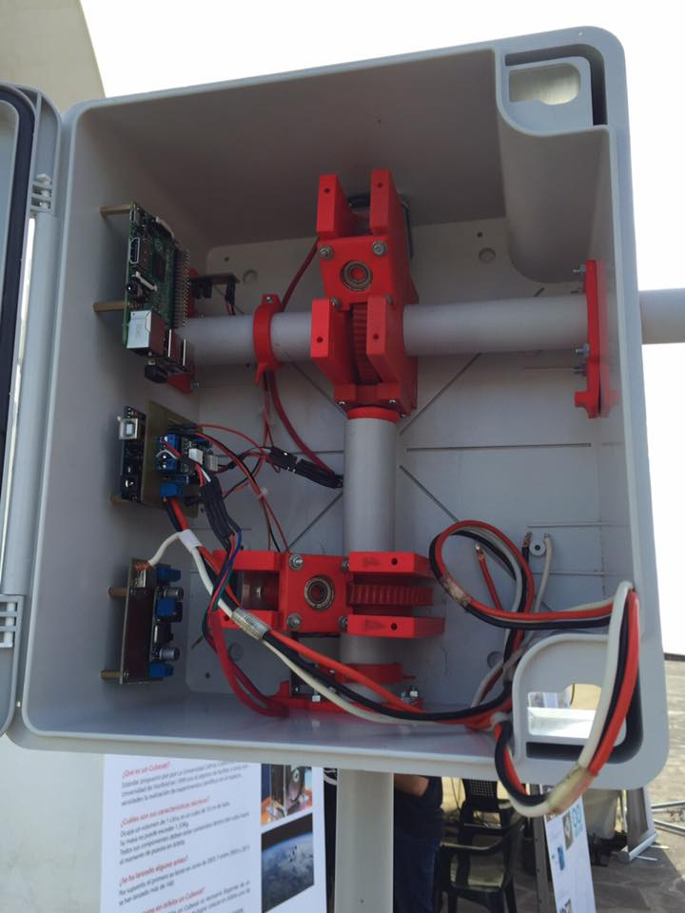
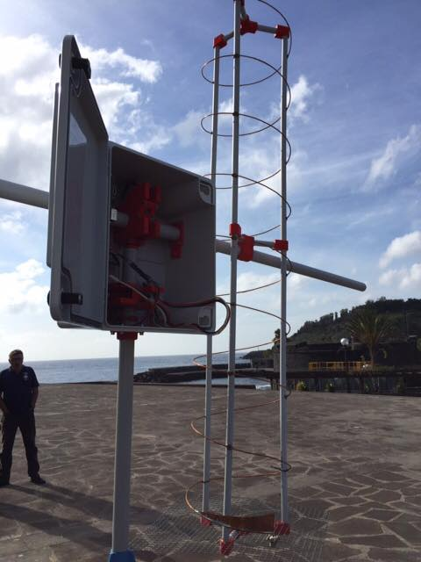
ACHIEVEMENTS
RADIO STATION (SATELLITE TRACKER)

Slide 18
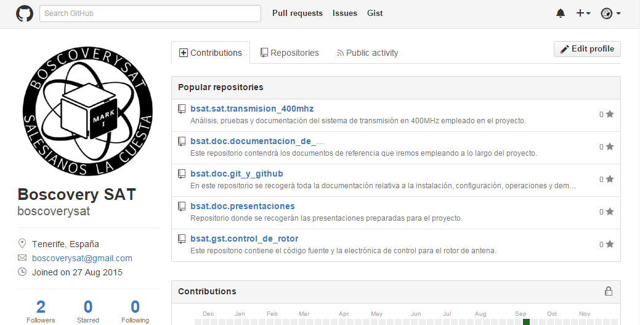
ACHIEVEMENTS
DOCUMENTATION

Slide 19
INDEX
Problem
Solution
Project Philosophy
Team
Achievements
Tools
Roadmap

Slide 20


TOOLS
COMMUNICATION
Gmail
Whatsapp

Slide 21


TOOLS
TEAMWORK
Google Drive
GitHub

Slide 22


TOOLS
MANAGEMENT
Google Calendar
Trello

Slide 23










TOOLS
DEVELOPMENT (SW & HW)
Editors and IDEs
Version Control
Operative Systems
Satellite & Tracker

Slide 24
INDEX
Problem
Solution
Project Philosophy
Team
Achievements
Tools
Roadmap

Slide 25
ROADMAP
It is a long time project
Apr
May
Jun
Jul
Aug
Sep
Oct
Nov
Dec
2016
Jan
Dec
2018
2015
2017
Jan
Dec
Jan
Jun

Slide 26
ROADMAP
Apr
May
Jun
Jul
Aug
Sep
Oct
Nov
Dec
2016
Jan
Dec
2018
2015
2017
Jan
Dec
Jan
Jun

Slide 27
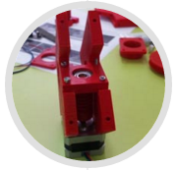
ROADMAP
Saint John Bosco La Cuesta School
Projects Week 2015
Satellite Tracker
Apr
May
Jun
Jul
Aug
Sep
Oct
Nov
Dec
2016
Jan
Dec
2018
2015
2017
Jan
Dec
Jan
Jun

Slide 28
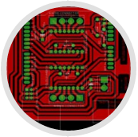
ROADMAP
Saint John Bosco La Cuesta School
Projects Week 2015
Satellite Tracker
Satellite Tracker
First systems development
Apr
May
Jun
Jul
Aug
Sep
Oct
Nov
Dec
2016
Jan
Dec
2018
2015
2017
Jan
Dec
Jan
Jun

Slide 29
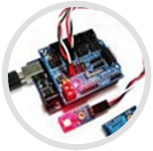
ROADMAP
Saint John Bosco La Cuesta School
Projects Week 2015
Satellite Tracker
Satellite Tracker
First systems development
Satellite
Orbital sensors testing
Apr
May
Jun
Jul
Aug
Sep
Oct
Nov
Dec
2016
Jan
Dec
2018
2015
2017
Jan
Dec
Jan
Jun

Slide 30
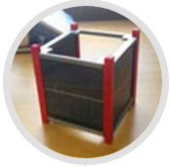
ROADMAP
Saint John Bosco La Cuesta School
Projects Week 2015
Satellite Tracker
Satellite Tracker
First systems development
Satellite
Orbital sensors testing
Apr
May
Jun
Jul
Aug
Sep
Oct
Nov
Dec
2016
Jan
Dec
2018
2015
2017
Jan
Dec
Jan
Jun
Satellite
Alfa 1 version released

Slide 31

ROADMAP
Saint John Bosco La Cuesta School
Projects Week 2015
Satellite Tracker
Satellite Tracker
First systems development
Satellite
Orbital sensors testing
Apr
May
Jun
Jul
Aug
Sep
Oct
Nov
Dec
2016
Jan
Dec
2018
2015
2017
Jan
Dec
Jan
Jun
Satellite
Alfa 1 version released
Phase #1 – Project definition and first developments.
Canary Islands Science Weeks

Slide 32
ROADMAP
Saint John Bosco La Cuesta School
Projects Week 2015
Satellite Tracker
Satellite Tracker
First systems development
Satellite
Orbital sensors testing
Apr
May
Jun
Jul
Aug
Sep
Oct
Nov
Dec
2016
Jan
Dec
2018
2015
2017
Jan
Dec
Jan
Jun
Satellite
Alfa 1 version released
Phase #1 – Project definition and first developments.
Phase #2 – Payload development and testing.
Canary Islands Science Weeks

Slide 33
ROADMAP
Saint John Bosco La Cuesta School
Projects Week 2015
Satellite Tracker
Satellite Tracker
First systems development
Satellite
Orbital sensors testing
Apr
May
Jun
Jul
Aug
Sep
Oct
Nov
Dec
2016
Jan
Dec
2018
2015
2017
Jan
Dec
Jan
Jun
Satellite
Alfa 1 version released
Phase #1 – Project definition and first developments.
Phase #2 – Payload development and testing.
Canary Islands Science Weeks
Phase #3 – Official tests and certifications.

Slide 34
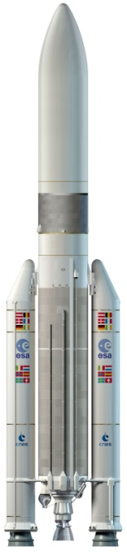
ROADMAP
Saint John Bosco La Cuesta School
Projects Week 2015
Satellite Tracker
Satellite Tracker
First systems development
Satellite
Orbital sensors testing
Apr
May
Jun
Jul
Aug
Sep
Oct
Nov
Dec
2016
Jan
Dec
2018
2015
2017
Jan
Dec
Jan
Jun
Satellite
Alfa 1 version released
Phase #1 – Project definition and first developments.
Phase #2 – Payload development and testing.
Canary Islands Science Weeks
Phase #3 – Official tests and certifications.
Phase #4 – Satellite launching.

Slide 35







boscoverysat@gmail.com
@boscoverysat
boscoverysat
boscoverysat.github.com
BoscoverySAT

Slide 36

boscoverysat@gmail.com
@boscoverysat
boscoverysat
boscoverysat.github.com
BoscoverySAT

Slide 37
A satellite with homespun electronics
December 2015

